Slide 1
Child Farm Labor: The Wealth Paradox
Sonia Bhalotra and Christopher Heady

Slide 2
Motivation
Wealth paradox: Children in land-rich households are often more likely to be in work
Challenge the common presumption that child labor emerges from the poorest households
Reason: failure of the markets for labor and land
Failure in credit market can offset such effect
Data: rural Pakistan and Ghana
Notes:
The vast majority of working children in developing countries are in
agricultural work, predominantly on farms operated by their families. Land is the
most important store of wealth in agrarian societies and it is typically distributed very
unequally.

Slide 3
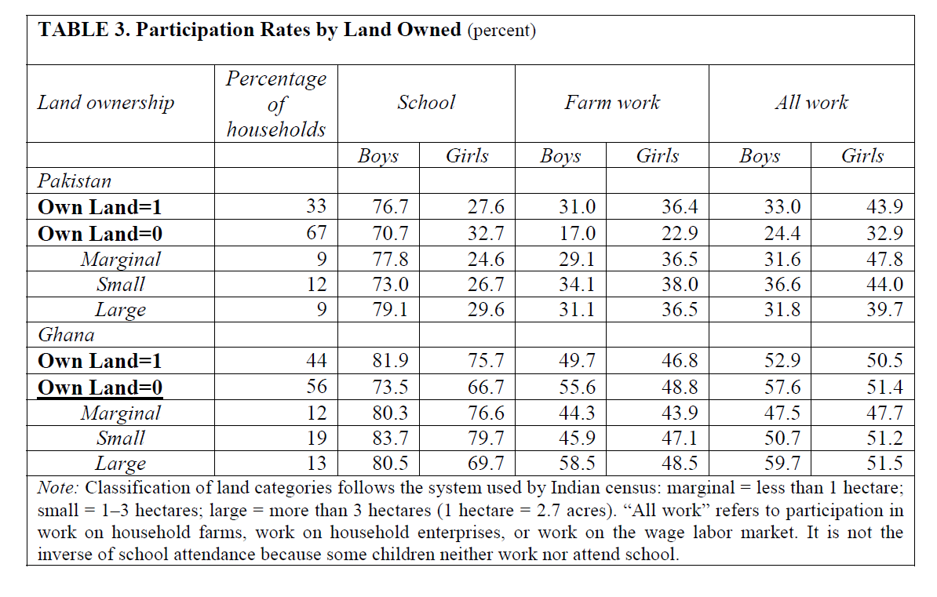
Wealth Paradox: Data

Slide 4
Channels to affect child labor
Wealth effect: Large landholdings generate higher income, make it easier for households to forgo the income that child work brings
Failure in capital market: lower interest rates for households to offer land as collateral reinforce the wealth effect, allows large landowners to borrow more to meet insurance needs or finance their children’s education

Slide 5
Channels to affect child labor
Failure in labor and land market: Owners of land who are unable to productively hire labor on their farms have an incentive to employ their children
Since the marginal product of labor is increasing in farm size, this incentive is stronger among larger landowners
Dynamic effect: The value of farm work experience will also tend to increase with farm size, an especially relevant factor if the child stands to inherit the family farm

Slide 6
Market Imperfections
Problem of moral hazard with hired labor may generate a preference for family labor
It is easy for hired labors to shirk because of stochastic agricultural output
Children are easier to supervise and discipline
Periodic labor shortages
Labor needs are seasonal and geographically concentrated
Land market failure
With perfect land market, large landowners that could not productively hire labor could sell or rent their lands rather than employ their children
Land market failure reinforces labor market failure

Slide 7
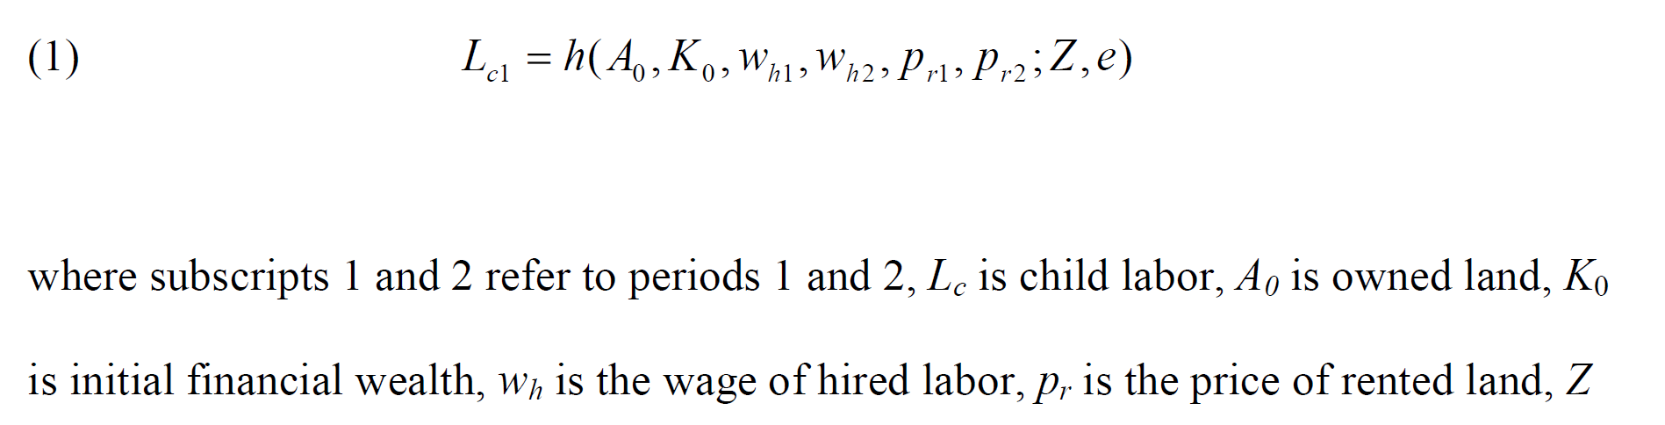
Model

Slide 8
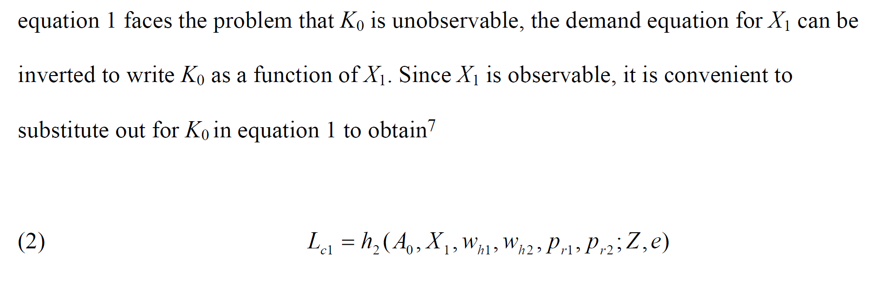
Model

Slide 9
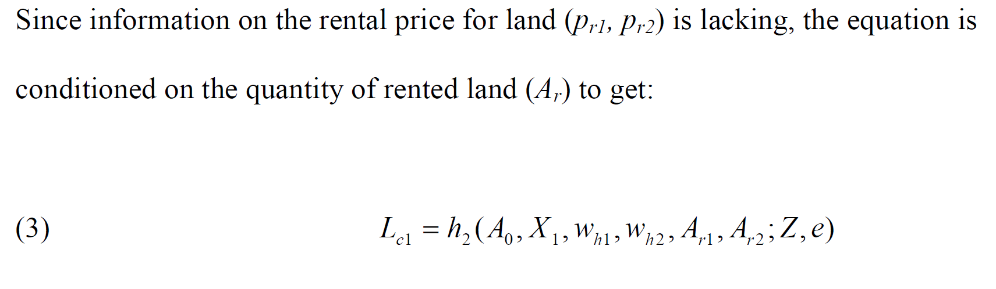
Model

Slide 10
Roles of Market Imperfections
Imperfect credit market will grant landowners weaker credit constraints, so that land will have negative effect on child labor
If both land and labor markets are imperfect, household will have an incentive to employ child labor, larger the landsize, stronger the incentive. So land will have a positive effect on child labor

Slide 11
Roles of Market Imperfections
With perfect land markets
positive incentive effect of land disappears even if labor market is imperfect, because land can be rented out with lack of labor
Negative collateral effect of land persists as long as credit market is imperfect
So zero coefficient on land if perfect credit market and negative if imperfect
Similar for the case of perfect labor market

Slide 12
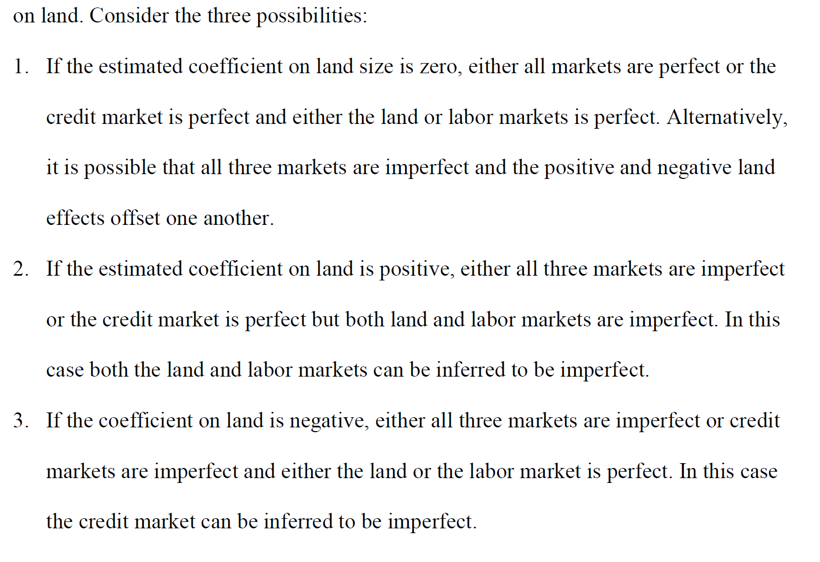
Roles of Market Imperfections

Slide 13
Empirical Model
Dependent variable: hours of child work on the family farm
Only the subsample of households that own or operate a family farm
46 percent in Pakistan and 90 percent in Ghana
Separate equations for boys and girls
Regressors: land size, mode of operation( sharecropping, use of free or village land, number of plots of land), food expenditure per capita to proxy household consumption, province dummies, agricultural wage rate for men to proxy wage of hired labor, etc.

Slide 14
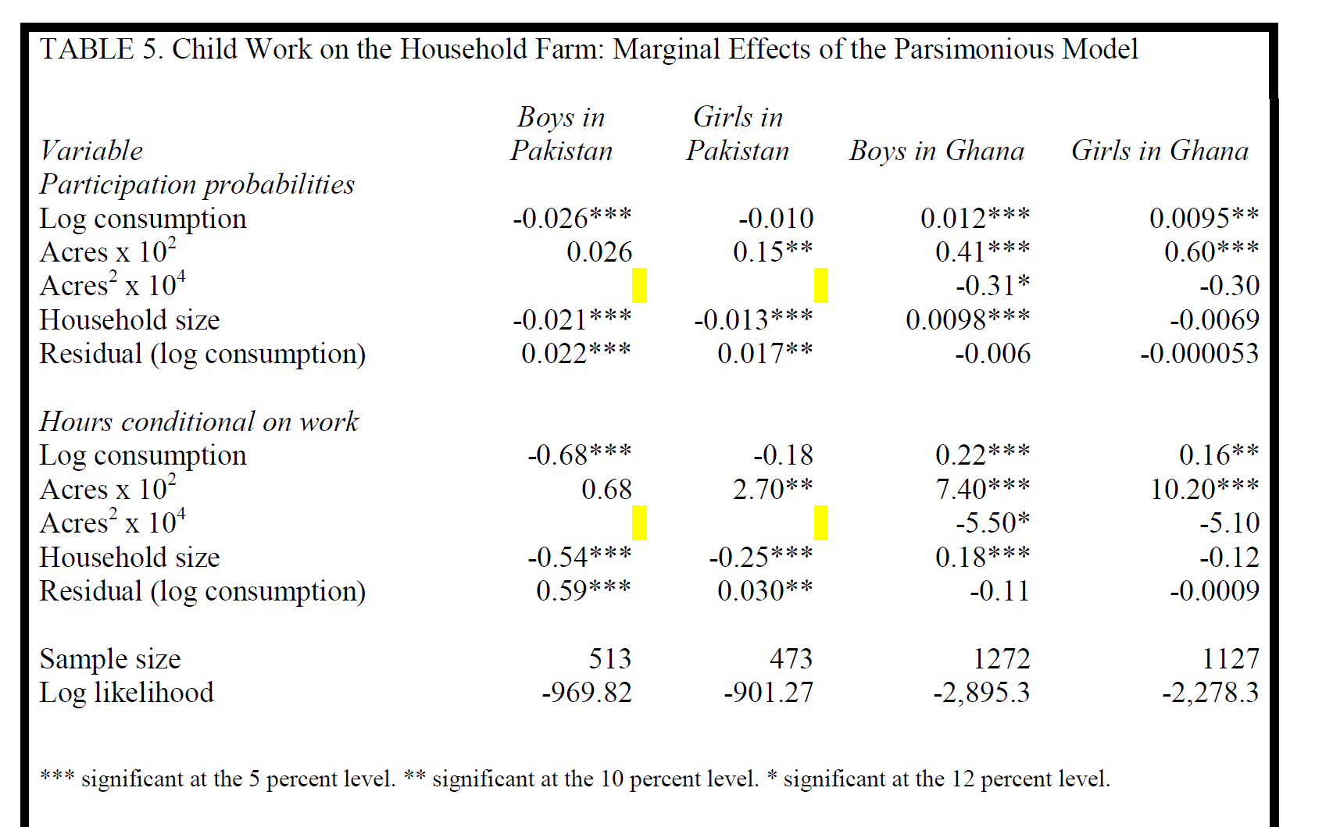
Results

Slide 15
Discussion
The hypothesis that farm size has a positive effect on child labor cannot be rejected
Signals imperfections in land and labor markets , consistent with imperfect credit markets, the effects of which are overwhelmed by land and labor markets
Why the results are stronger for girls than for boys?
Girls are less of a perfect substitute for hired labor
Returns to education for boys are more favorable
Parents prefer to invest in sons because they traditionally look after parents in future

Slide 16
Policy implications
Invest in raising the returns to education, especially providing subsidies to parents who send their daughters to school.
Reduce labor market discrimination against women and girls, and raise awareness in order to reduce inhibiting social norms.
Improve functioning of labor and land markets in rural areas. Develop rural financial markets may have positive spillover effects, encouraging development of land and labor markets.

